Slide 1
LOOPS
Lecturer: Nadia Binte Asif

Slide 2
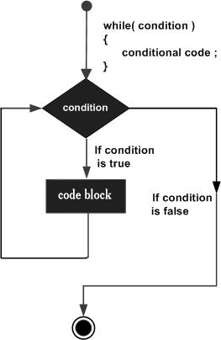
While Loop
The loop iterates while the condition is true.
Condition expression is compulsory.
While → without a body is possible.
Initialization before loop
Update statement → Inside loop body
while(condition) {
statement(s);
}

Slide 3
#include<stdio.h>
int main () {
/* local variable definition */
int a = 10;
/* while loop execution */
while( a < 20 ) {
printf("value of a: %d\n", a);
a++;
}
return 0;
}
a=? | a<20? | Inside Loop Body | Update
10 | True | value of a: 10 | a = a+1= 10+1 =11
11 | True | value of a: 11 | a = 11+1 = 12
12 | True | value of a: 12 | a = 12+1 = 13
13 | True | value of a: 13 | a = 13+1 = 14
14 | True | value of a: 14 | a = 14+1 = 15
15 | True | value of a: 15 | a = 15+1 = 16
16 | True | value of a: 16 | a = 16+1 = 17
17 | True | value of a: 17 | a = 17+1 = 18
18 | True | value of a: 18 | a = 18+1 = 19
19 | True | value of a: 19 | a = 19+1 = 20
20 | False

Slide 4
i = ? | i<=10 ? | Number =50 Loop Body | Update
1 | True | Number*i = 50 * 1 = 50 | i = i+1 = 2
2 | True | 50 * 2 = 100 | 2+1 =3
3 | True | 50 * 3 = 150 | 3+1 =4
4 | True | 50 * 4 = 200 | 4+1 = 5
5 | True | 50 * 5 = 250 | 5+1 = 6
6 | True | 50 * 6 = 300 | 6+1 = 7
7 | True | 50 * 8 = 400 | 7+1 = 8
8 | True | 50 * 9 = 450 | 8+1 = 9
9 | True | 50 * 10 = 500 | 9+1 =10
10 | True | 50 * 11 = 550 | 10+1 =11
11 | False [break]
#include<stdio.h>
int main(){
int i=1,number=0,b=9;
printf("Enter a number: ");
scanf("%d",&number);
while(i<=10){
printf("%d \n",(number*i));
i++;
}
return 0;
}

Slide 5
#include<stdio.h>
void main ()
{
int j = 1;
while(j+=2,j<=10)
{
printf("%d ",j);
}
printf("%d",j);
}
#include<stdio.h>
void main ()
{
while()
{
printf("hello everyone");
}
}
Output
compile time error: while loop can't be empty
Output
3 5 7 9 11
while(1){
//statement
}
If the expression passed in while loop results in any non-zero value then the loop will run the infinite number of times.

Slide 6
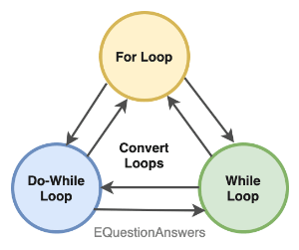
LOOP CONVERSIONS
/* For loop */
int i;
for(i = 0; i < 10; i++)
{
}
/* For loop converted to while loop */ int i = 0; /* <<< Initialization */ while(i < 10) { i++; }

Slide 7
Problems
C program to find sum of natural numbers from 1 to n
Program to count total digits in a given integer using loop
Program to find reverse of a number
Program to check palindrome number

Slide 8
/**
* C program to count number of digits in an integer
*/
#include <stdio.h>
int main()
{
long long num;
int count = 0;
/* Input number from user */
printf("Enter any number: ");
scanf("%lld", &num);
/* Run loop till num is greater than 0 */
while(num != 0){
/* Increment digit count */
count++;
/* Remove last digit of 'num' */
num /= 10;
}
printf("Total digits: %d", count);
return 0;
}

Slide 9
/**
* C program to find reverse of a number
*/
#include <stdio.h>
int main()
{
int num, reverse = 0;
/* Input a number from user */
printf("Enter any number to find reverse: ");
scanf("%d", &num);
/* Repeat the till 'num' becomes 0 */
while(num != 0)
{
/*
* Increase place value of reverse and
* add last digit to reverse
*/
reverse = (reverse * 10) + (num % 10);
/* Remove last digit from 'num' */
num /= 10;
}
printf("Reverse = %d", reverse);
return 0;
}

Slide 10
/**
* C program to check whether a number is palindrome or not
*/
#include <stdio.h>
int main()
{
int n, num, rev = 0;
/* Input a number from user */
printf("Enter any number to check palindrome: ");
scanf("%d", &n);
/* Copy original value to 'num' to 'n'*/
num = n;
/* Find reverse of n and store in rev */
while(n != 0)
{
rev = (rev * 10) + (n % 10);
n /= 10;
}
/* Check if reverse is equal to 'num' or not */
if(rev == num)
{
printf("%d is palindrome.", num);
}
else
{
printf("%d is not palindrome.", num);
}
return 0;
}

